Slide 1

Self-Balancing Unicycle
Client: Andy Chang (National Instruments)
Supervisor: Dr. Robert Throne
Leader: Kevin Collins
Members: Spencer Carver
Ander Solorzano
Ruffin White-Magner
Team
G
Notes:
Kevin

Slide 2
Project Overview
Project Plan
Status
Parts
Controls
Modeling
Conclusion
Build a self-balancing robotic unicycle for National Instruments (NI), using NI components where possible
Notes:
Kevin
We have been asked by national instruments to design and build a self balancing unicycle robot to showcase NI’s newest robotics toolkit.
National Instruments has developed a full solution to solving challenging controls problems with real time components, and this project is meant to show how a challenging controls problem can be solved using their components.
Our task is to develop a self balancing, autonomous unicycle style robot that can withstand disturbances such as light pushing. It does not have to navigate to a specific point or move at all, it only needs to balance independantly.

Slide 3
Overview
Status
Parts
Controls
Modeling
Conclusion
Project Plan - Overview
Approach the build in stages:
STAGE 1: Robotics Environment Simulator
STAGE 2: State Space Control Design
STAGE 3: NI CompactRIO Real-Time Controller
STAGE 4: Integration & Debugging
Notes:
Kevin
Our basic approach to the project is broken up into 4 stages
We will start by modeling the system in the labview robotics environment simulator, and
After we have an accurate model, we will develop our control algorithms within labview using the simulator.
Once we are confident in our control algorithms, we will build a physical robot using a cRIO real time controller to control it.
After we have a physical prototype, there will need to be a lot of debugging. As we can already tell, the simulation environment is great, but may not produce the most accurate models, so there will need to be a lot of time at the end for fine tuning our control algorithms.

Slide 4
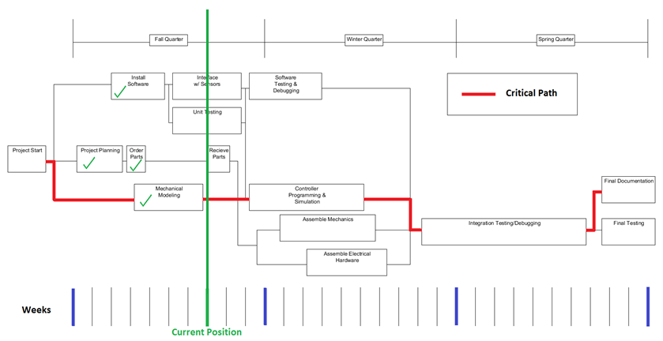
Overview
Status
Parts
Controls
Modeling
Conclusion
Project Plan – Planning Flow Chart
Notes:
Kevin
Here you can see our project plan. The green line represents our current position in the plan, the checkboxes representing what has been accomplished. The fall has been and will continue to be primarily laying the groundwork for our project. We would like to have all of our components and make sure that we understand how they work and how to use them effectively. Then next quarter, we will be able to quickly and efficiently develop a control algorithm and build a physical model that will hopefully result in a working prototype by the end of the quarter. Then spring quarter is left entirely for debugging and final documentation.

Slide 5
Overview
Project Plan
Parts
Controls
Modeling
Conclusion
Current Status – Progress
According to our flow chart, the current tasks are:
Interface w/ Sensors
Unit Testing
Receive Parts
Our parts arrived just before fall break, and we are currently in the process of interfacing with them and testing with the systems we have been exploring
Notes:
Kevin

Slide 6
Overview
Project Plan
Parts
Controls
Modeling
Conclusion
Current Status – Team Progress
Hours spent on project as of 10/15/2012: 165
Spencer Carver: 34
Kevin Collins: 40
Ander Solorzano: 37.5
Ruffin White-Magner: 53.5
Tasks Recently Completed:
Mechanical Model – Kevin Collins & Ruffin White-Magner
Receive Parts– Ander Solorzano
Tasks Currently In Progress:
Simulation – Kevin Collins & Ruffin White-Magner
Interface w/ Sensors – Spencer Carver, Ander Solorzano, & Ruffin White-Magner
Research Real-Time VIs – Spencer Carver & Ander Solorzano
Notes:
Kevin

Slide 7
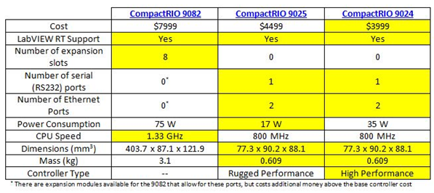
Overview
Project Plan
Status
Controls
Modeling
Conclusion
Determining Parts– Decision Matrices: Overview
Notes:
Spencer

Slide 8
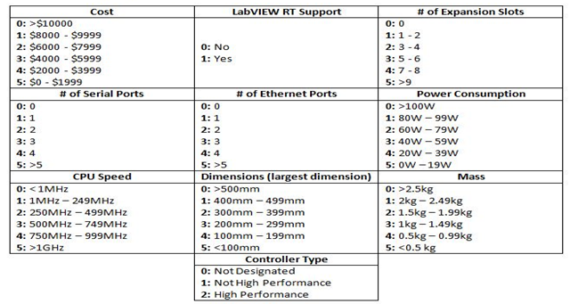
Overview
Project Plan
Status
Controls
Modeling
Conclusion
Determining Parts – Decision Matrices: Weights
Notes:
Spencer

Slide 9
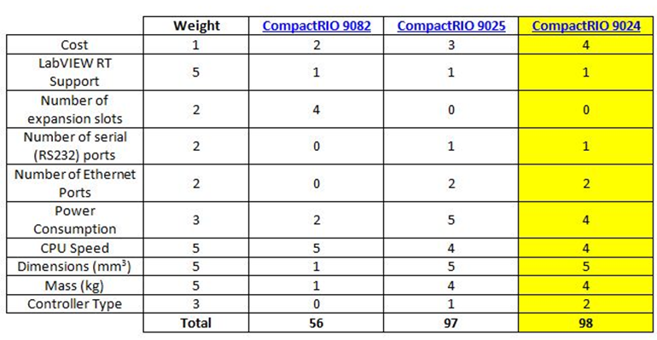
Overview
Project Plan
Status
Controls
Modeling
Conclusion
Determining Parts – Decision Matrices: Evaluation
Notes:
Spencer

Slide 10
Overview
Project Plan
Status
Controls
Modeling
Conclusion
Determining Parts – Budget
Total Cost: $27,740
Notes:
Spencer

Slide 11
Overview
Project Plan
Status
Controls
Modeling
Conclusion
Determining Parts – Budget
Total Cost: $4,740
Notes:
Spencer

Slide 12
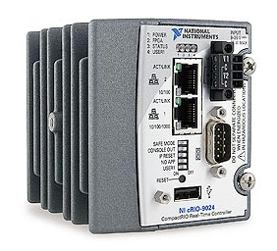
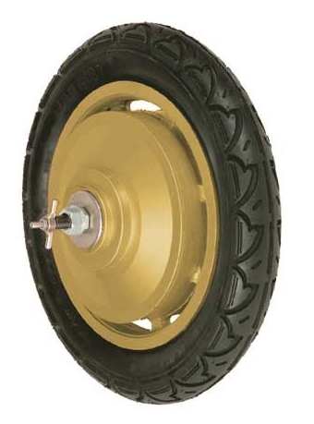
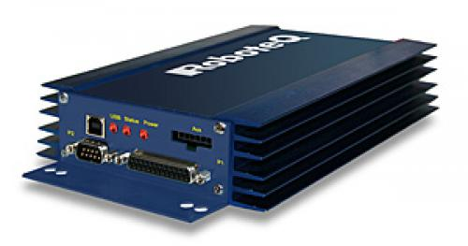
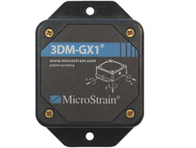
Overview
Project Plan
Status
Controls
Modeling
Conclusion
Determining Parts – Electrical Components
CompactRIO Real-Time Controller
In-Hub Motors
Motor Controllers
Inertial Measurement Unit (IMU)
Notes:
Spencer

Slide 13
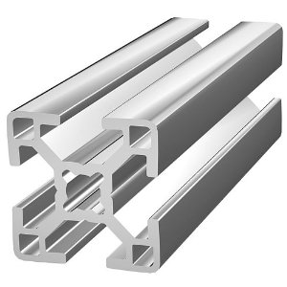
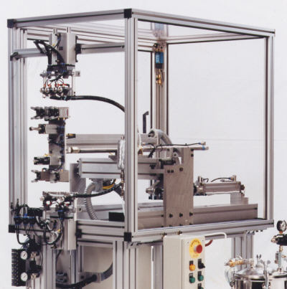
Overview
Project Plan
Status
Controls
Modeling
Conclusion
Determining Parts – Structural Components
Plan to use Aluminum Extrusion
The material is very easy to use, sturdy, and relatively inexpensive
Very adaptable for future changes and adjustments
Brackets will also be necessary to construct the frame
Notes:
Spencer
Once we have all of the electrical components, we will build

Slide 14
Overview
Project Plan
Status
Parts
Modeling
Conclusion
Control Strategy
Self Balancing Unicycle
Non-linear system
Feedback
Real-Time operation
Dynamically unstable
Discrete time
Autonomous
Controllable system
Notes:
Ander

Slide 15
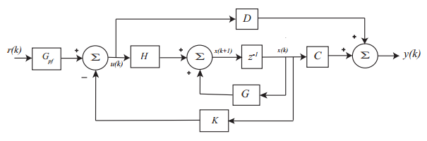


Overview
Project Plan
Status
Parts
Modeling
Conclusion
Control Strategies – Mathematical Model
Non-linear problem → Linearize → Use state variable description
Discrete time state variable feedback system
State Variable Equations
x(k) = state vector
u(k) = input vector to the plant
y(k) = output vector from the plant
G,H,C,D matrices are constant
K = feedback gain matrix
$$x\left(k+1\right)=G∗x\left(k\right)+H∗u\left(k\right)$$
$$y\left(k\right)=C∗x\left(k\right)+D∗u(k)$$
Notes:
Ander

Slide 16
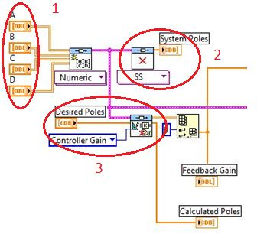
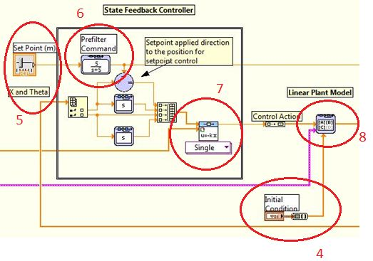
Overview
Project Plan
Status
Parts
Modeling
Conclusion
Control Strategies - LabVIEW
State Vectors A,B,C,D
Dynamic Analysis computes poles
Determines controller gain based on desired poles
Set initial conditions
Alter pole placement
Apply prefilter
Compute controller feedback output
Implement model in state-space form
Notes:
Ander

Slide 17
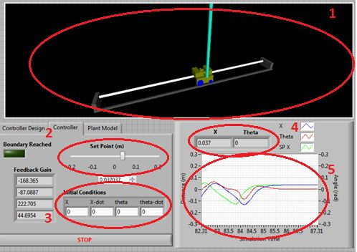
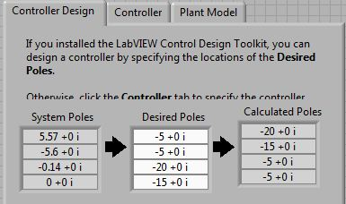
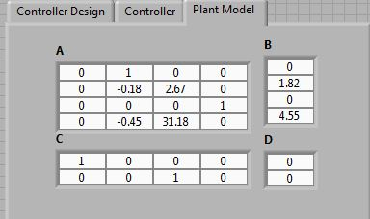
Overview
Project Plan
Status
Parts
Modeling
Conclusion
Control Strategies – LabVIEW Front Panel Example
System model
Alter system’s position
Set initial conditions
Position (x) and pole angle (Theta) real-time outputs
Plot of system output
Placing Poles in the system
Modify the plant model
Notes:
Ander

Slide 18
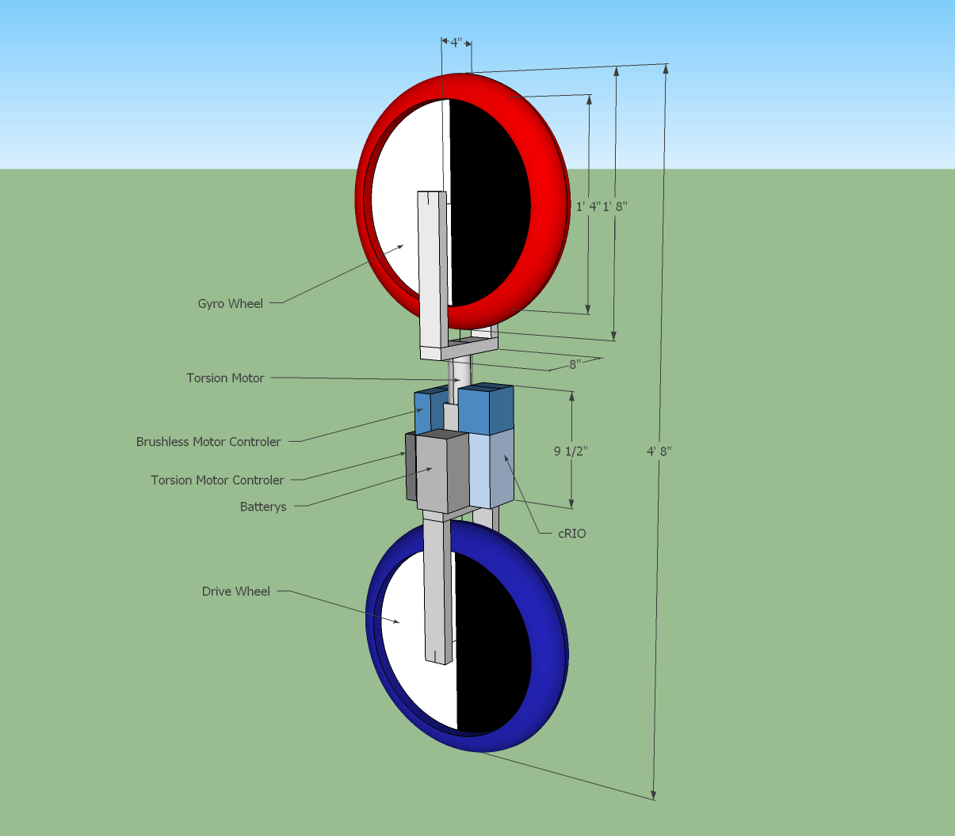
Problem Description
Project Plan
Status
Parts
Controls
Conclusion
Modeling
Notes:
Ruffin
Includes 3 moving joints, all motorized
Balanced Placement of components
High degree of symmetry
Center of gravity in the middle

Slide 19
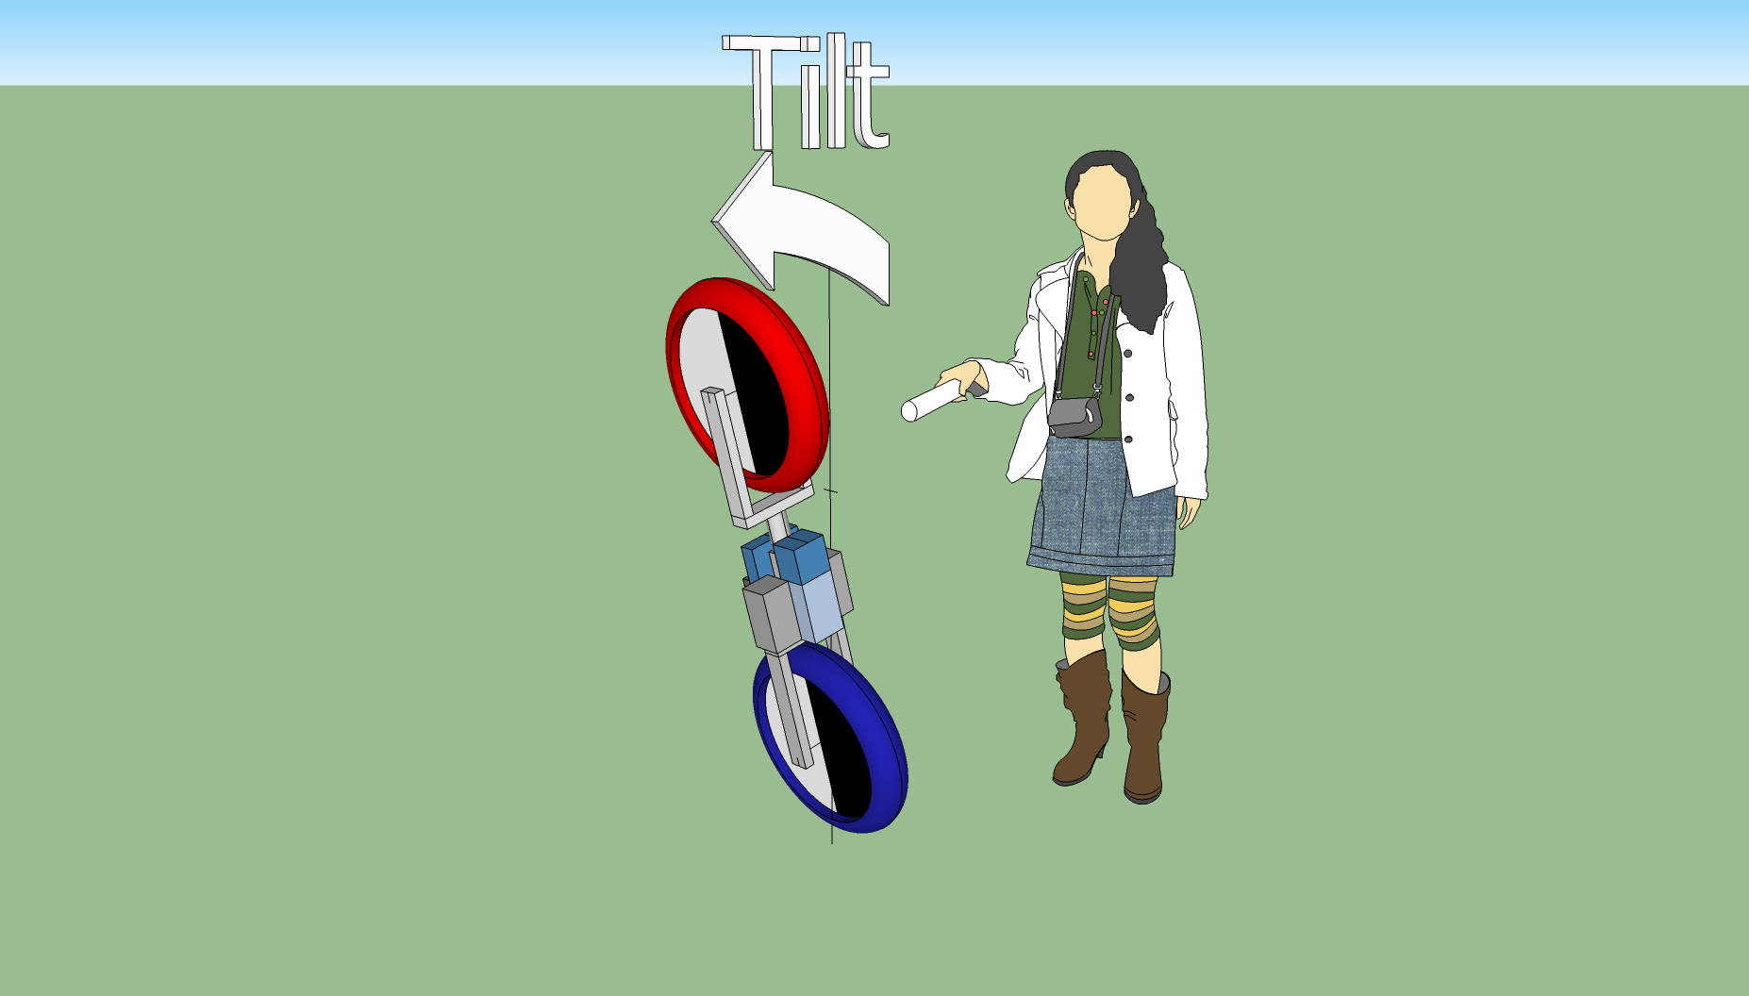
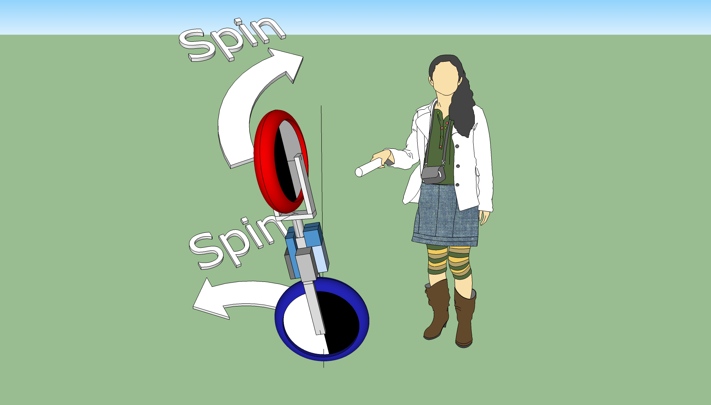
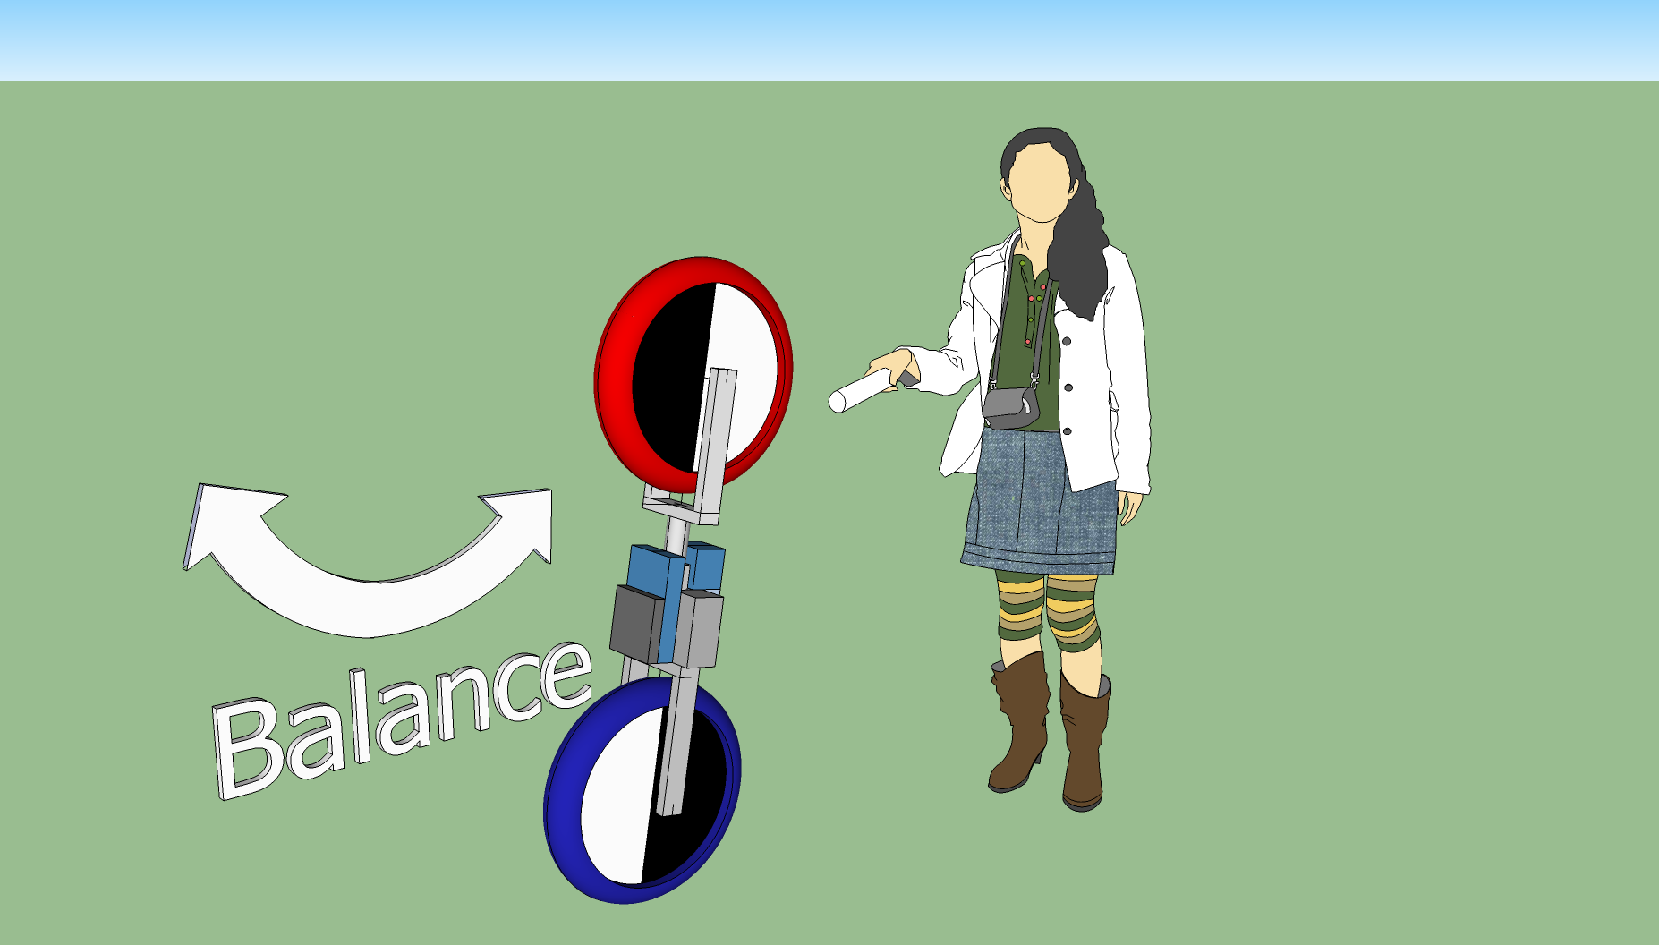
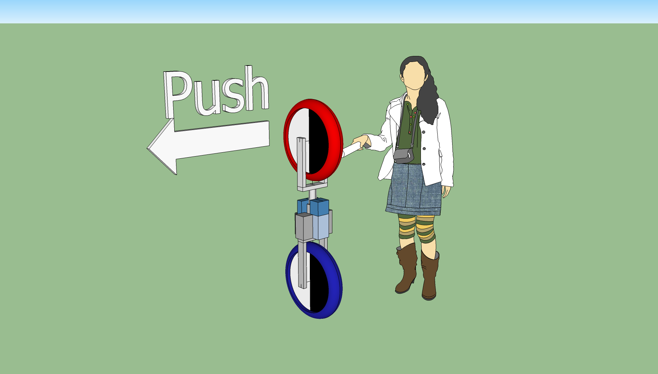
Problem Description
Project Plan
Status
Controls
Conclusion
Modeling - Proposed Balancing Mechanism
Notes:
Ruffin
Robot is displaced by an external force
Robot tilts off in the Y direction
IMU reads this displacement of side to side motion
1st system control
Torsion motor turns the gyro clockwise
This torques the bottom frame counter clockwise
This continues until the IMU is displaced only in the forward and backward frame
2nd system control
Then once the robot has resumed a single plane of displacement
parallel with the drive wheel
the system acts an inverted pendulum and proceeds to balance forward and backward

Slide 20
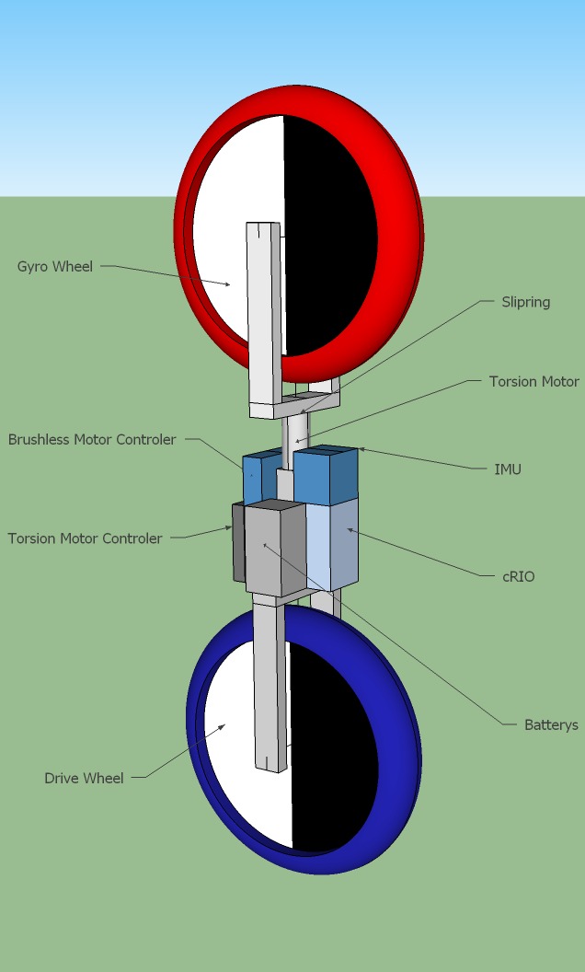
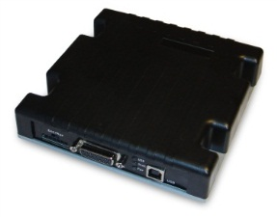

Problem Description
Project Plan
Status
Parts
Controls
Conclusion
Modeling - Part Locations
Notes:
Ruffin
Basic part placement

Slide 21
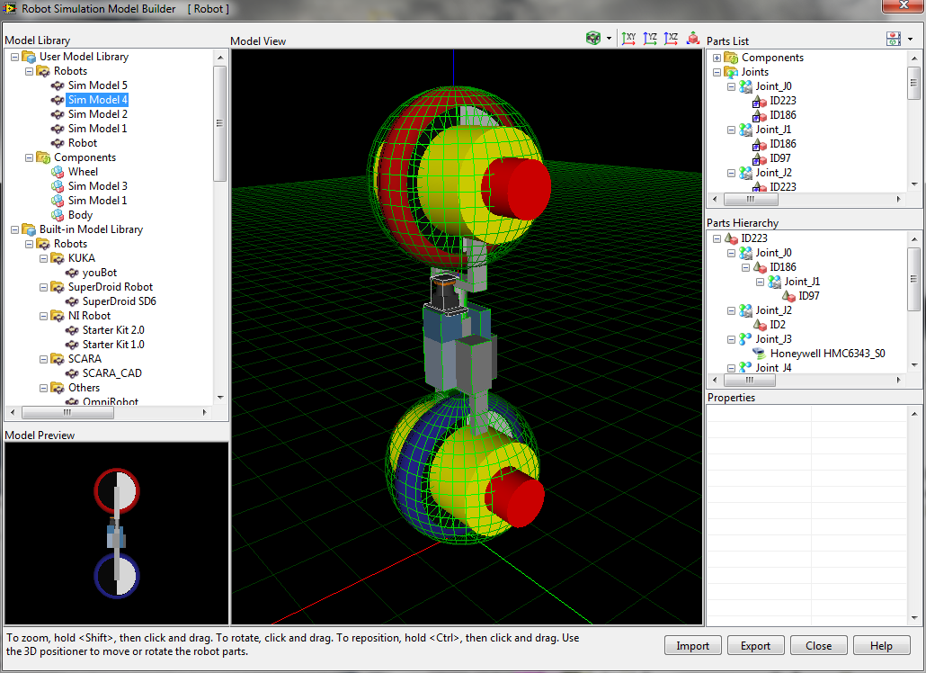
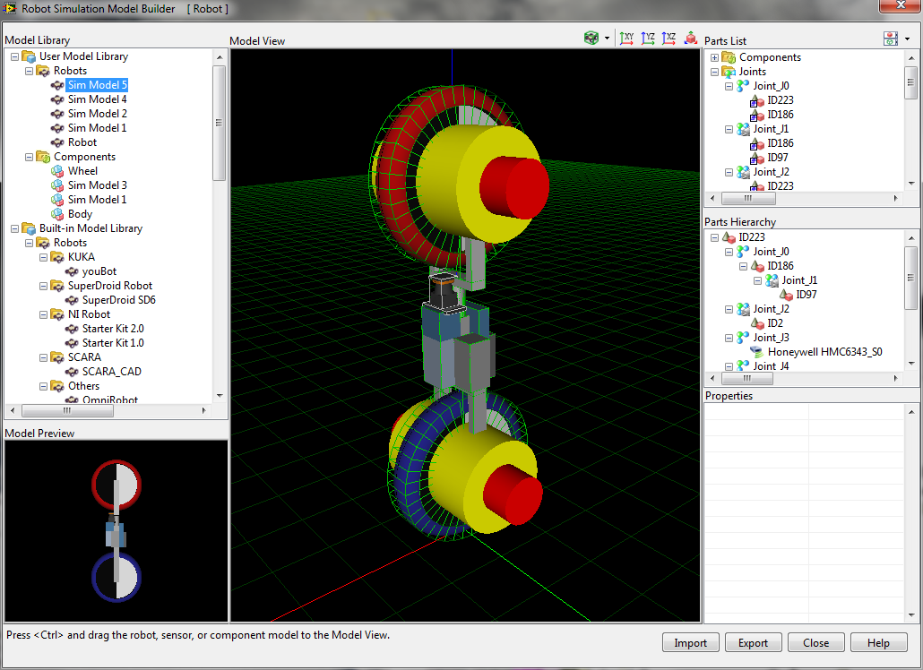
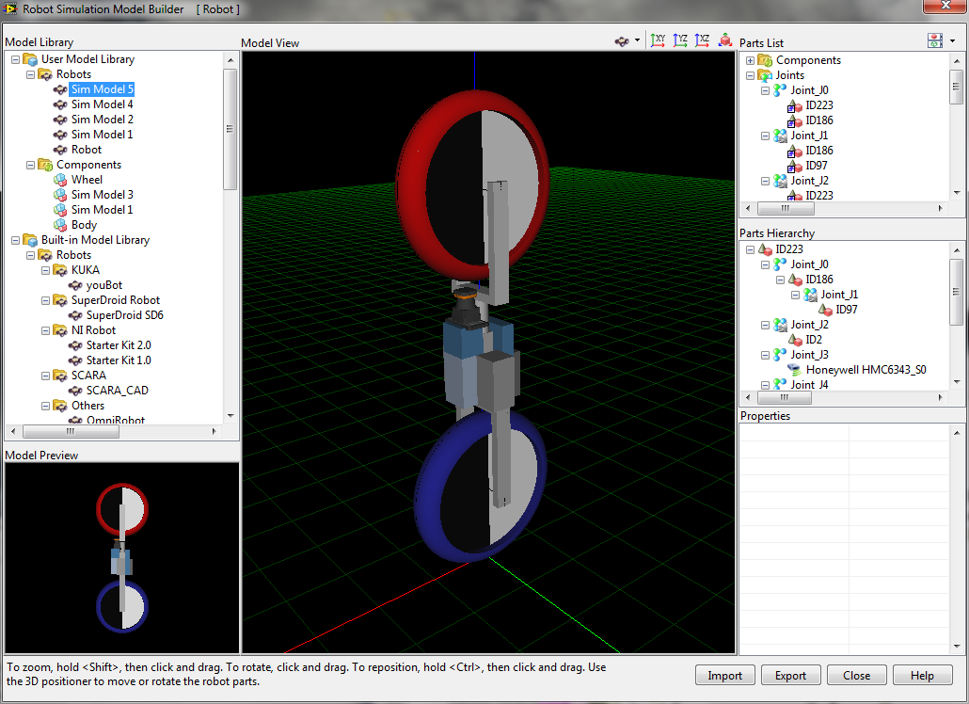
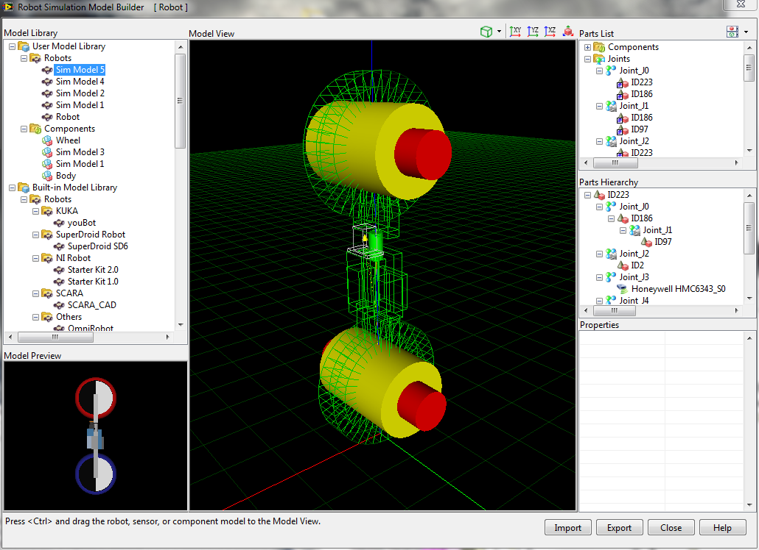
Problem Description
Project Plan
Status
Parts
Controls
Conclusion
Modeling– Simulation
Notes:
Ruffin
Labview Robotics Simulation Builder
With actuator and sensors
Build levels of complexity

Slide 22
Overview
Project Plan
Status
Parts
Controls
Modeling
Conclusion - Questions
Notes:
Kevin

Slide 23
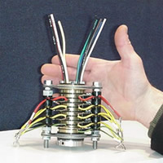
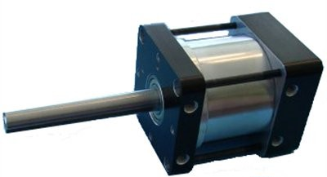
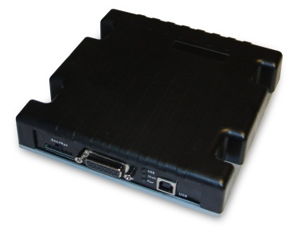
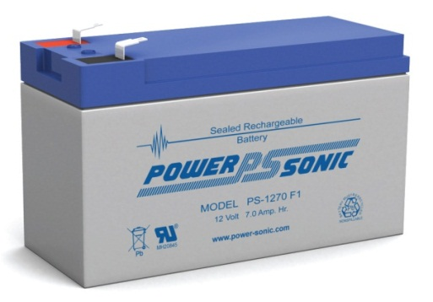
Notes:
Add a legend/number representation for all components!

